Slide 1
Welcome to my presentation

Slide 2
My presentation topic is Doorbell Ringer using or gate
Submitted by Submitted to
Name –All-amin Md.Mamunur Rahman
Student Id -213002019 lecturer of Green university of . Bangladesh
Course code:DLD 204
Section: 213D2

Slide 3
Doorbell Ringer
We all have a doorbell at our homes. When a visitor comes to our house, he searches for the doorbell switch and then rings it to let us know his presence.

Slide 4
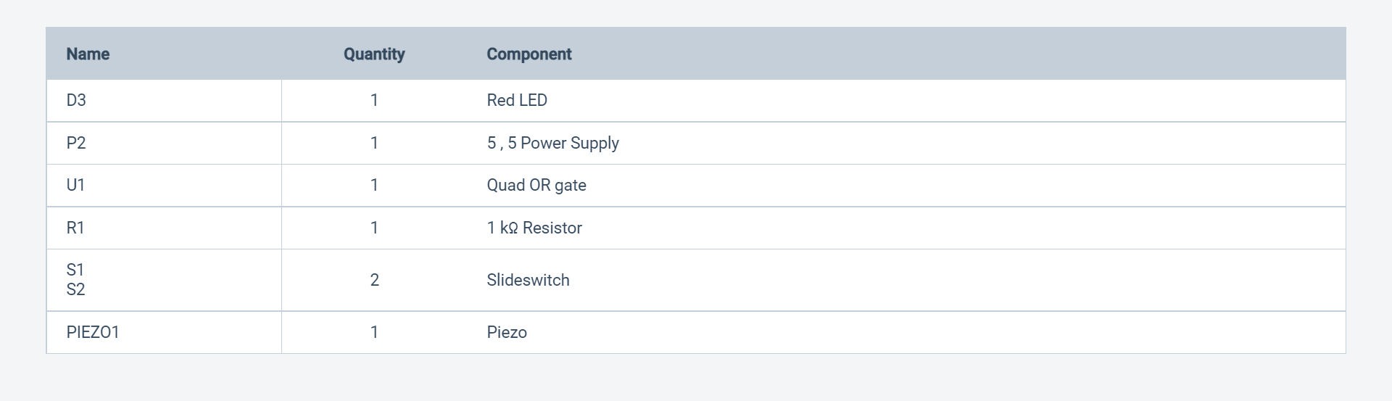
What component use Door bell ringer using or gate

Slide 5
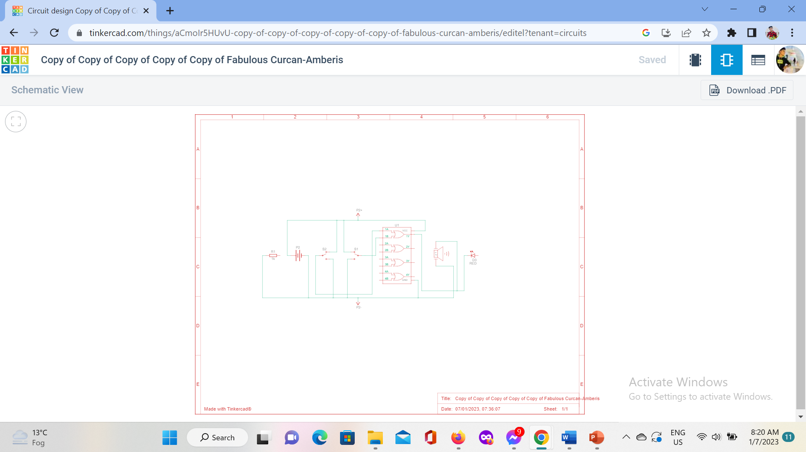
Circuit diagram

Slide 6
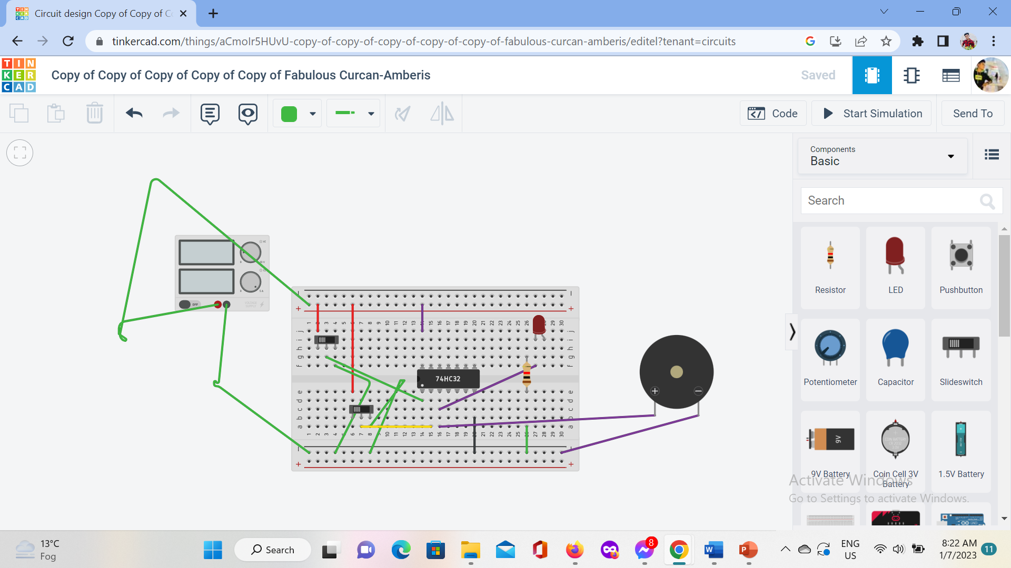
Doorbell ringer using or gate.

Slide 7
Why need door bell ringer…..
Door Ringer Video Doorbell is a technologically advanced product that will provide timely notifications whenever a visitor is identified at the front door of a home.

Slide 8
DO YOU HAVE ANY QUESTION?
Thank you

